Slide 1

Data Analyst Professional Practical Exam Submission
Pens & Printers Product Sales Data Analysis Report
by Julia Karaulnik

Slide 2
Table of contents
Introduction
Exploratory Analysis
Business Metric
Recommendations

Slide 3
Introduction
Pens and Printers was founded in 1984 and provides high quality office products to large organizations.
Pens and Printers is a trusted provider of everything from pens and notebooks to desk chairs and monitors. They don’t produce their own products but sell those made by other companies.
New Product Sales Methods:
Six weeks ago they launched a new line of office stationery. Three different sales strategies were tested for this.
Email: 1st week and 3 weeks later.
This required very little work for the team.
Call: ~ 30 min per customer.
Email and Call: an email in the 1st week and a call in the 2nd week.
The email required little work from the team, the call was ~ 10 min per customer.
Notes:
Six weeks ago they have launched a new line of office stationery. Three different sales strategies were tested for this: targeted email and phone calls, as well as combining the two.
Email: Customers in this group received an email when the product line was launched, and a further email 3 weeks later. This required very little work for the team.
Call: Customers in this group were called by a member of the sales team. On average members of the team were on the phone for around 30 minutes per customer.
Email and Call: Customers in this group were first sent the product information email, then called a week later by the sales team to talk about their needs and how this new product may support their work. The email required little work from the team, the call was around 10 minutes per customer.

Slide 4
Business Goals
How many customers were there for each approach?
What does the spread of the revenue look like overall? And for each method?
Was there any difference in revenue over time for each of the methods?
Which method would you recommend we continue to use?
Which business metrics should business choose to monitor?

Slide 5
Dataset
15000 rows, 8 columns
week
sales_method
customer_id
nb_sold (# of products sold)
revenue
years_as_customer
nb_site_visits (# of site visits)
state
Only 3 variables need cleaning:
sales_method
Wrong data
revenue
Missing values
years_as_customer
Wrong data
Dataset after cleaning and validating: 14,998 rows and 8 columns.
Notes:
The dataset initially consisted of 15,000 rows and 8 columns, containing a mix of three categorical and five numerical features before undergoing the validation and cleaning process.

Slide 6

Exploratory data analysis

Slide 7
Number of customers
Notes:
Upon examining the data, the distribution of customers approached via different methods is as follows:
Email: The "Email" approach constituting approximately 50% of the total approaches.
Call: The "Call" approach accounted for roughly 33% of the total.
Email + Call: The "Email + Call" method had the lowest number of customers approached, consisting of approximately 17% of the total approaches.

Slide 8
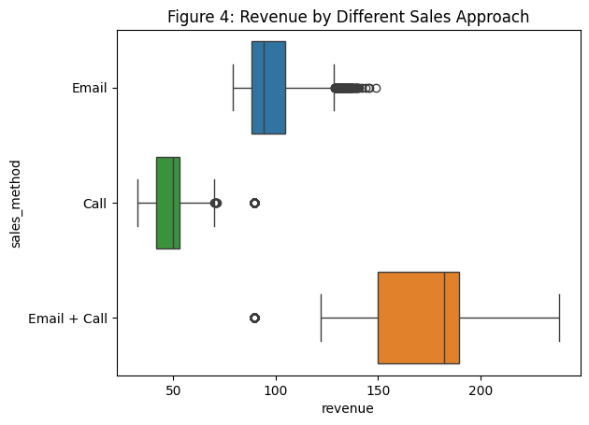
Revenue by sales approach
 | Total | Percentage
Email | $720.9 | 51.34%
Call | $439.5 | 31.30%
Email+Call | $243.7 | 17.36%
 | Min | Avg | Max
Email | $78.8 | $96.6 | $149.0
Call | $89.5 | $170.9 | $238.3
Email+Call | $32.5 | $39.1 | $89.5
Notes:
From the summarized Revenue by Sales Approach in the grouped revenue table and Figure 4, several key insights emerge:
Total Revenue by Each Approach: Email stands out as the top revenue generator, which aligns with its extensive customer outreach. However, what's intriguing is that "Email + Call" secures the second position in terms of total revenue, almost twice the revenue of "Call".
Revenue Range Per Customer Variation: "Email + Call" exhibits the widest range, indicating high variability and high revenue. In contrast, "Call" has a narrower range, suggesting low variability, and "Email" ranges from 78.83 USD to 148.97 USD.
Concentration of Values: An in-depth analysis reveals that most of the revenue for "Email + Call" clusters around 170.88 USD, demonstrating the highest average revenue per customer. This figure is nearly double that of "Email“ and approximately four times that of "Call".
These findings offer a fascinating perspective on revenue generation. While "Email" dominates in terms of total revenue, the remarkable performance of "Email + Call" stands out with its higher average revenue and broader revenue range. "Call," on the other hand, faces challenges despite significant efforts (approximately 30 minutes per customer), and the average revenue earned per customer remains relatively low after 6 weeks.

Slide 9
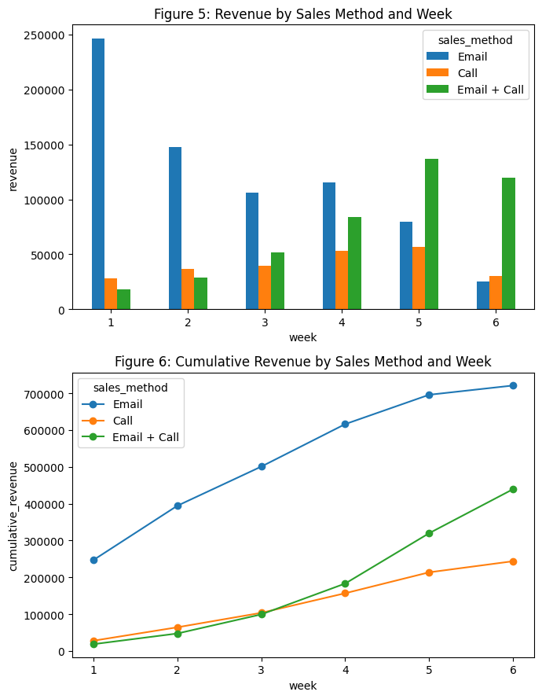
Revenue over time
Email group’s revenue decreased while the other two increased.
Notes:
The element of time (week) was added to revenue. Demonstrating a number of further insights:
Revenue Trends Over Time: While the total revenue of "Email" decreases over the weeks, the total revenue of "Call" and "Email + Call", on the other hand, increased as the weeks progressed.
"Comparison": From the third week onwards, "Email + Call" starts to consistently outperform the cumulative revenue of the "Call" approach, and this difference increases as the weeks progress. This indicates that "Email + Call" becomes more lucrative than "Call" over time. Meanwhile, "Email" seems to be more effective in the first few weeks after launching but decreased over time.

Slide 10
Recommended sales approach
"Email + Call" approach stands out as the most effective strategy:
Smallest number of customers – 2572
Total revenue of $439k, rank no.2
Highest average revenue per customer: $170.88 per customer
$84k revenue increase weekly (just 10k less than “Call”)
Notes:
"Email + Call" approach stands out as the most effective strategy for the sales team to target.

Slide 11
Business Metric
Average Revenue per Customer by Sales Method
It measures the effectiveness of each sales approach ("Email," "Call," and "Email + Call") in terms of revenue contribution per customer.
Can be a baseline to choose the right sales approach, set performance targets, monitor changes in revenue in subsequent weeks or future marketing campaigns.
Initial Values:
Email + Call: $170.88 per customer
Email: $96.57 per customer
Call: $49.13 per customer
Notes:
Average Revenue per Customer by Sales Method
The "Average Revenue per Customer by Sales Method" metric is defined as the average revenue generated from customers for each of the different sales methods employed by the business.
It measures the effectiveness of each sales approach ("Email," "Call," and "Email + Call") in terms of revenue contribution per customer.
Can be used as baseline to choose the right sales approach, set performance targets, monitor changes in revenue in subsequent weeks or future marketing campaigns.

Slide 12
Recommendations
Prioritize "Email + Call": Given its superior revenue performance over time, the business should consider allocating more resources and focus on the "Email + Call" approach. This approach has the potential to maximize revenue and reach a broader customer base.
Targeted "Emails": The "Email" approach also displayed somewhat positive results that tended upwards throughout the 6-week period. Thus, it is suggested that the company focusses on implementing more targeted messages in their emails into their strategy as this could be a way to add some extra revenue to the pipeline with relatively no extra effort.
Continuous Monitoring: Regularly track and analyze the "Average Revenue per Customer by Sales Method" metric to refine sales strategies and adapt to changing customer behaviors. This will lead to improved revenue generation strategies over time.
Improve Data Collection practices: There were 1074 missing values in the revenue column and this missing information could be the difference between achieving the goal or not. Thus, it is important to pay extra attention to Data Quality and Collection techniques.
Notes:
Hopefully, the given findings and recommendations will be helpful for future sales strategies. Thank you for your attention!

